Slide 1
Predicting Automotive Industry Technological Trends Using NLP Techniques
Team Members
Elsa Ho
Peiying Wu
Ruiqing Lyu
Vince Yao Jing

Slide 2
Problem Statement and Hypotheses
Problem Statement: What are the technological trends in the automotive industry? How should the company strategize their financial planning based on the trends?
Analyze textual data from automotive companies’ 10-k/annual reports to extract:
Are car companies straying away from the core of their business
What car companies are striving towards in the future in terms of innovation and technology
Hypotheses:
There is a positive relationship between the company’s Research and Development (R&D) spending and how innovative the company is.
There is a positive relationship between the company’s Research and Development (R&D) spending and the company’s revenue from the previous year

Slide 3
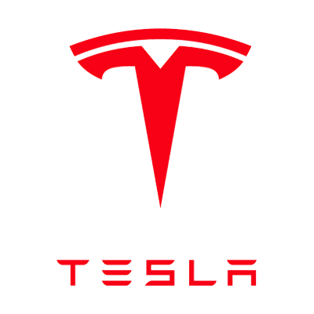


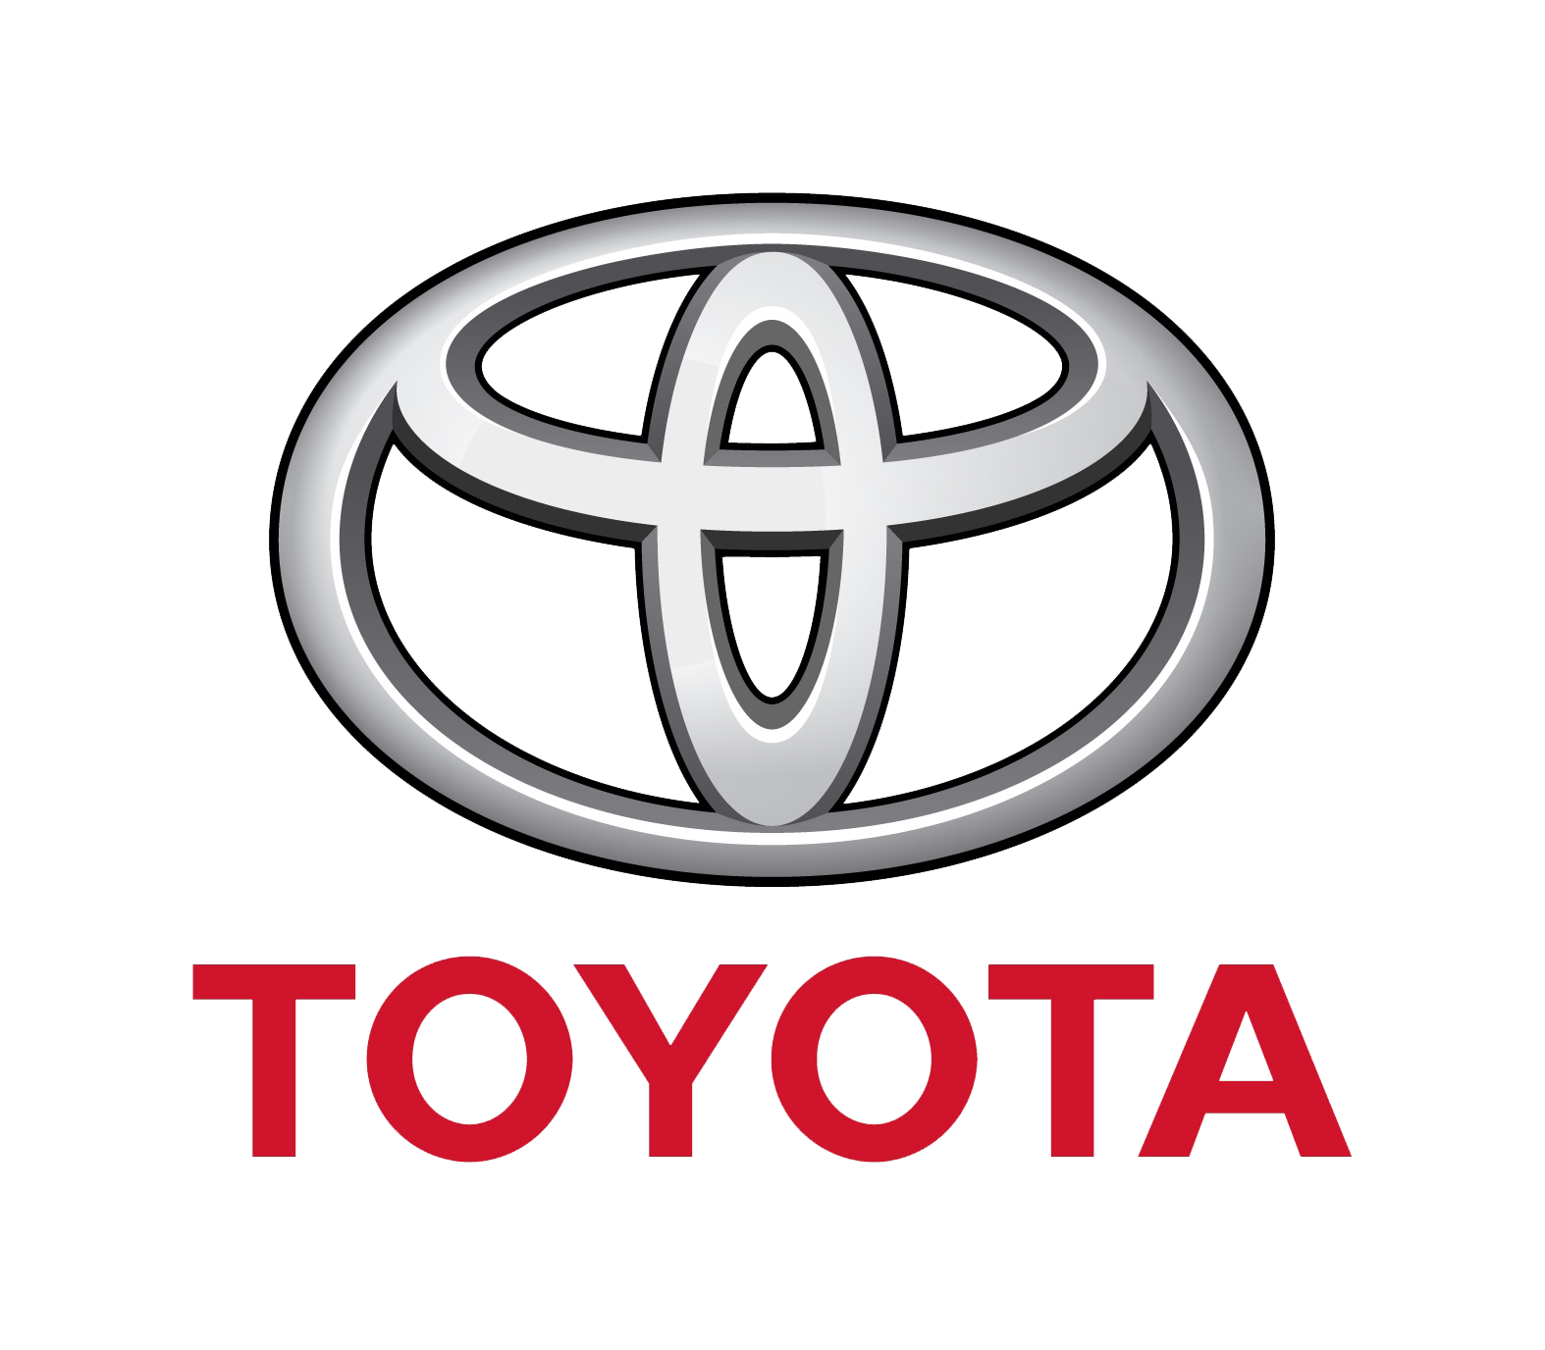


Data
Data Source: 6 years (2013 - 2018) of 10-k/annual reports of selected 6 companies in Automotive Industry
Text Extraction Sections: Business Overview, Goals and Strategies, Risk Factors and etc.
Business Overview : describing the company’s business, including its main products and services
Goals and Strategies: discussing the future directions of the company’s business
Risk Factors: outlining the most significant risks that apply to the company and the industry
Financial Data: Revenue, R&D Expenses, Market Capitalization
In-scope companies:

Slide 4
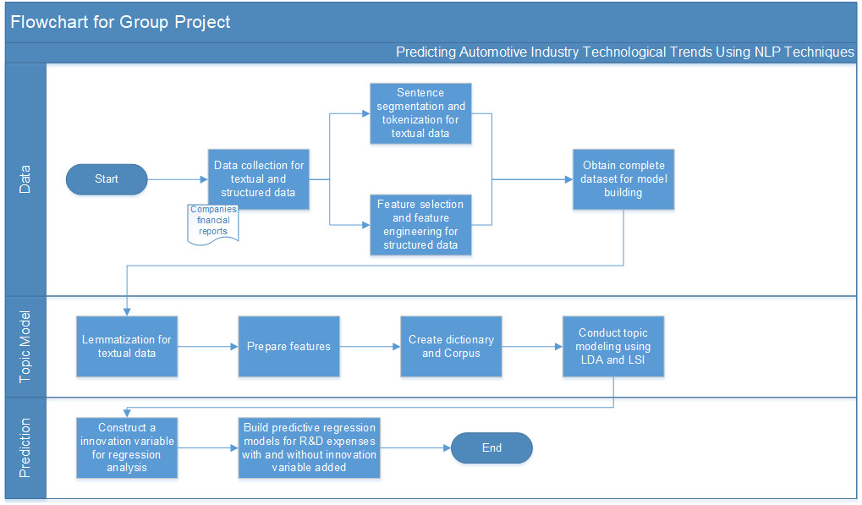
Methodology – Overall Flowchart

Slide 5


Methodology - Model Building
Choosing LDA (Latent Dirichlet allocation) to analyze the large amount of textual data extracted from the 10-k/ annual reports
Data preprocessing: stop words removal, punctuation
Comparing the performance of bi-gram and tri-gram for LDA model - Tri-gram prevails
Bi-gram
Tri-gram

Slide 6
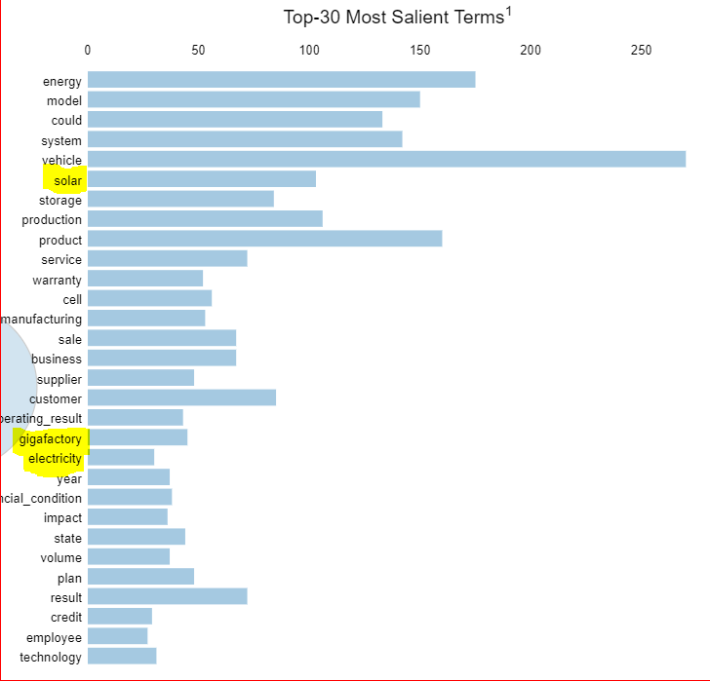
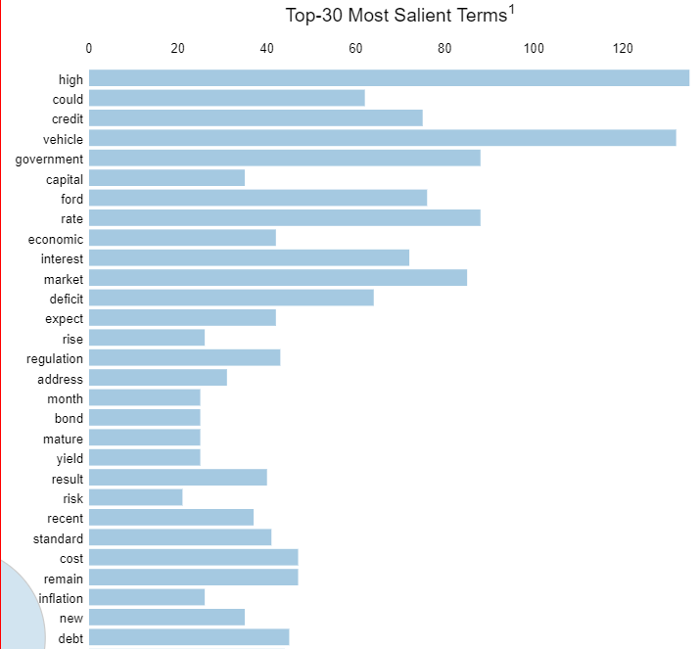
Methodology – Innovation score
Innovative
Traditional

Slide 7
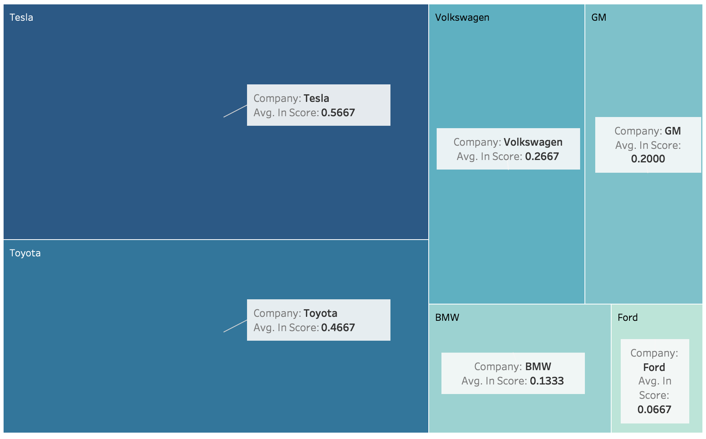
Results - Topic Modeling
Innovation Score: Calculated according to the weights of innovative technologies related-topics generated from the LDA topic modeling
Tesla has the highest average innovation score while Ford has the lowest score
Average Innovative Score Summarized by Companies

Slide 8
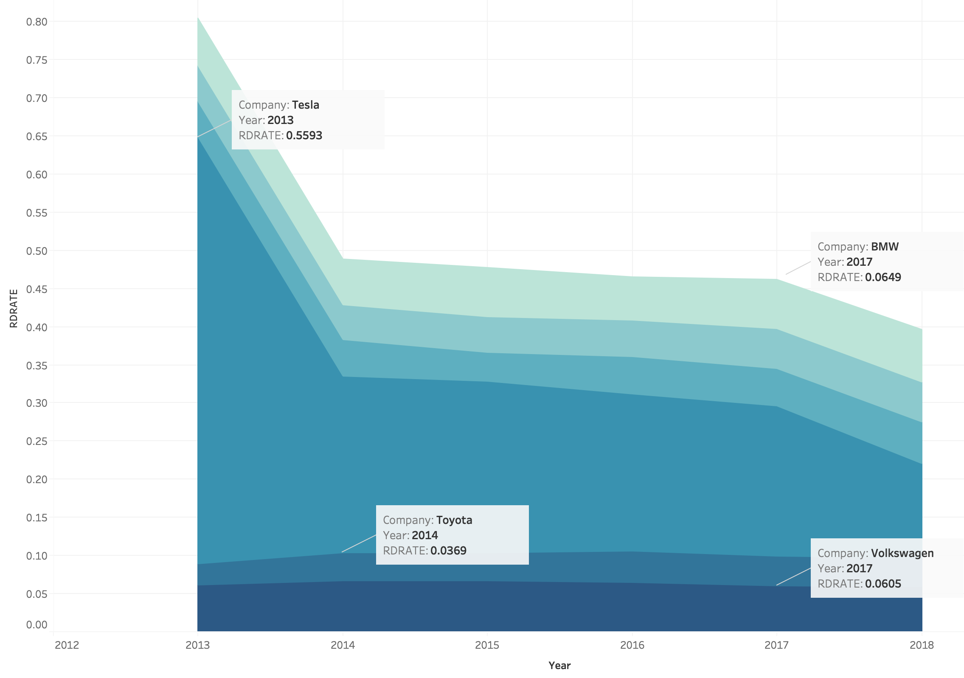
Results - Topic Modeling
R&D Spending Rate: current year R&D expense as a percentage of previous year revenue
A significant component of the company’s financial planning and budgeting process, measuring quantitatively how the management is strategizing the R&D initiatives of the company
Tesla invests larger portion of its revenue on R&D initiatives while Toyota invests the least
R&D Spending Rate from 2013 - 2018 Summarized by Companies

Slide 9
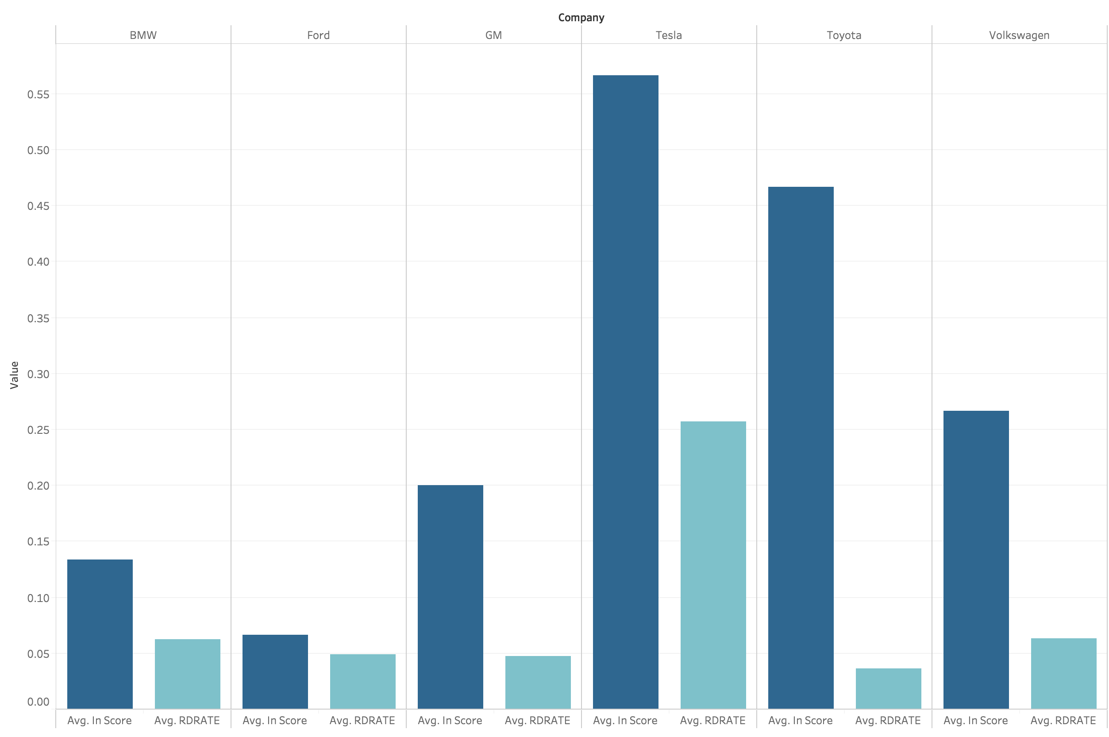
Results - Topic Modeling
Consistency: Tesla has the highest innovative score on average and it also invests the largest percentage of its revenue on R&D each year
Misalignment: Toyota has the second highest innovative score according to its 10-k however it invest the least on R&D on average
Comparison between Average Innovative Score and Average R&D Rate (CY R&D/PY Revenue) Summarized by Companies

Slide 10
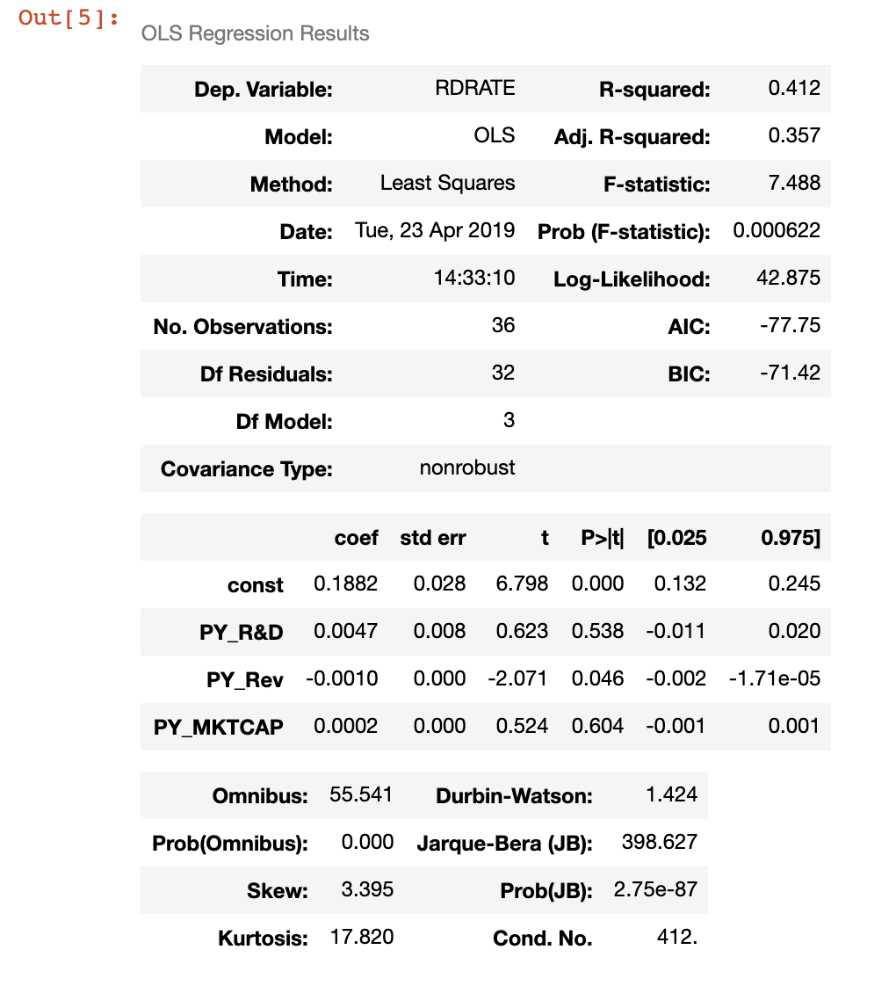
Results - Predictive Model
Dependent variable: R&D spending rate
Independent Variables:
Previous year R&D expenses
Previous year revenue
Previous year market capitalization
Adjusted R-squared: 0.357

Slide 11
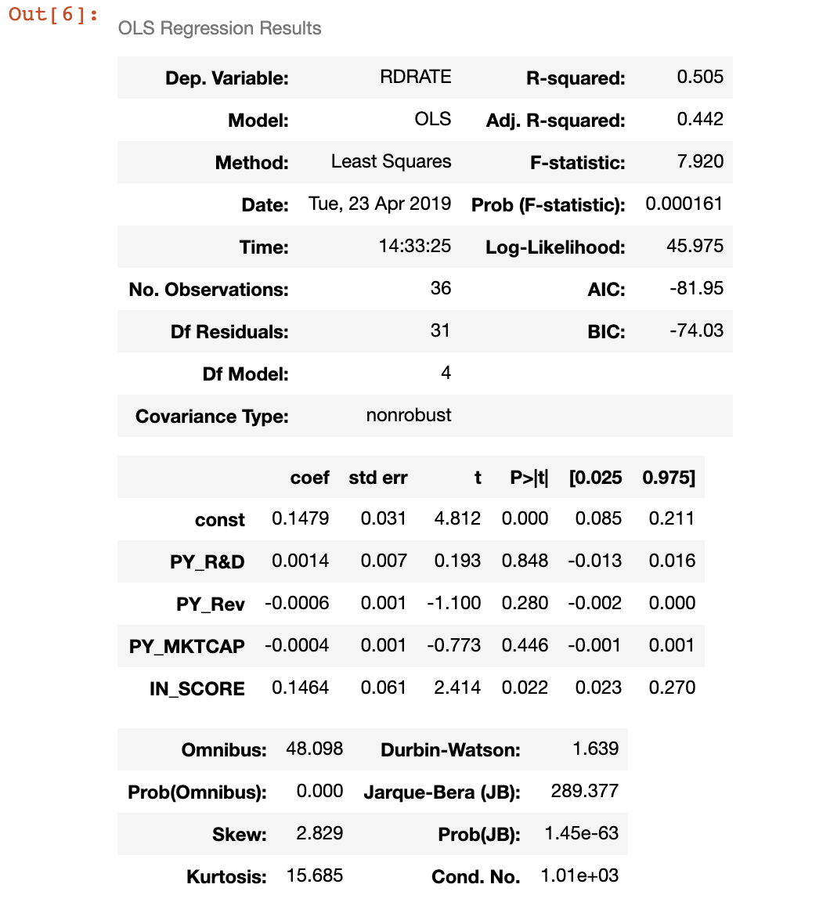
Results - Predictive Model
Dependent variable: R&D spending rate
Independent Variables: adding innovation score into the model
Adjusted R-squared: Increased by 24%
There is a positive relationship between the R&D spending rate and the innovation score

Slide 12
Conclusions and Recommendations
Conclusions
Disadvantage
Recommendations
Text analytics results indicate Tesla is leading the technological trends (electric vehicles, autonomous driving) in the industry, Ford is falling behind
Financial data analysis suggests Tesla invests heavily on R&D, which is in line with its 10-k reports. Toyota spends the least, contrasting with what is mentioned in its reports
Adding innovation score improves the model performance to predict the R&D spending
Automotive companies should prioritize their R&D initiatives according to their business objectives
EVs and autonomous driving technologies would be prevailing in the foreseeable future. More funding could be allocated to such domains based on the companies’ positioning in the industry
More sources and factors can be considered in order to conduct more in-depth trend analysis

Slide 13
Thank you!

